Slide 1
Student Financial Aid
What Students & Parents Should Know
Notes:
Welcome to the New York State Higher Education Services Corporation’s presentation on “Student Financial Aid: What High School Students and Parents Should Know.”
The Higher Education Services Corporation, or HESC, is New York State’s higher education student financial aid agency.
At HESC we administer New York State’s Tuition Assistance Program (TAP) along with 20 different state-sponsored scholarship and student loan forgiveness programs. In addition we conduct outreach programs for students and families to inform them about student financial aid opportunities.
During this presentation we will review how the financial aid system works, what programs are available and the application process.

Slide 2
What is Financial Aid?
Financial aid helps pay the cost of attending college
Financial aid may awarded based on
Financial need (need-based)
Other criteria, such as academic or athletic ability (merit-based)
Notes:
So to begin, let’s discuss what financial aid is.
Financial aid programs are intended to provide funding to students to help them pay for the cost of attending college.
Financial aid programs are awarded from several different sources and qualifications may be based on either financial need or other non-need-based criteria, such as academic excellence or athletic ability.
With need-based aid your family’s ability to pay for college costs is evaluated using income and asset information collected from financial aid applications such as the FAFSA (the Free Application for Federal Student Aid).
Non-need-based financial aid is more commonly referred to as merit-based aid.

Slide 3
Different Types of Aid
Scholarships
Grants
Work Study
Loans
Free Money
Self-help aid
Notes:
It is important that you understand that there are different types of financial aid awards available for students.
Scholarships and grants are “free money” or gift aid – meaning you do not have to pay any of the money back. Many scholarships and grants are awarded through the financial aid application process and may be either need-based or merit-based.
Work-study and student loans are called self-help aid because they require the recipient to either work to earn their assistance or pay them back plus interest.
Remember, when you are applying for financial aid -- always go for the “free money” first!

Slide 4
Sources of Financial Aid
Federal government
New York State
Colleges – Institutional aid
Other sources
Businesses
Foundations
Clubs/Organizations
Notes:
The federal government, New York State, colleges and other organizations are all sources of financial aid. We will discuss the different types of aid each of these sources offer in a moment.

Slide 5
How Financial Need is Determined
Cost of Attendance (COA)
– Expected Family Contribution (EFC)
= Financial Need
Notes:
First, let’s talk more about how students qualify for need-based financial aid.
This is the formula colleges use to calculate a student’s financial need. Cost of Attendance minus Expected Family Contribution equals financial need.
The Expect Family Contribution is calculated using the Federal government’s formula based on student and parent information entered on the student’s FAFSA application. We will discuss the type of information FAFSA requests from applicants a bit later.
Let’s talk more about the Cost of Attendance component of this formula.

Slide 6
Cost of Attendance (COA)
Tuition and fees
Room and board
Books and supplies
Transportation
Miscellaneous expenses
COA – EFC = Financial Need
Notes:
The cost of attendance, or COA as it is commonly called, is determined by each college.
The following components are always included in the college’s cost of attendance:
Tuition and fees
Room and board
Books and supplies
Transportation
Miscellaneous expenses
There are additional components that may be added, such as study abroad expenses, that may be included based on a student’s actual situation or program of study. However, they are not automatically included in a COA.
College choice plays a huge role in what a student’s Cost of Attendance will be. These choices include whether or not the student will live on-campus or be a commuter, study at an in-state versus an out-of-state school, or if they are considering attending a public or private college.

Slide 7
Examples of Need Determination
 | College A | College B | College C
COA | $ 15,000 | $30,000 | $60,000
- EFC | 5,000 | 5,000 | 5,000
= Financial Need | $ 10,000 | $ 25,000 | $55,000
Notes:
This sample chart demonstrates a student’s eligibility for need-based financial aid based across three different priced colleges with an Expected Family Contribution of five thousand dollars.
As mentioned earlier, the EFC calculated from the student’s FAFSA stays the same across all the different colleges.
In the example you see that the student qualifies for need-based aid at all three colleges. However, at colleges priced the same as College C the student will have the greatest need.
Now that we know how need is determined, let’s take a look at some of the financial aid programs that a student may receive to help cover their college costs.

Slide 8
Common Financial Aid Question: Eligibility
If we don’t think we qualify for need-based financial aid, do we still go through the process of applying?
Many families mistakenly believe they do not qualify
Always consult with colleges, the FAFSA application may be needed for merit-based aid recipients
Notes:
Since FAFSA is used to determine financial need, some students and parents ask “If we don’t think we qualify for need-based financial aid, do we still file the FAFSA?”
The answer is “Yes!”
HESC always encourages students and parents to apply for financial aid. We find many families mistakenly believe they do not qualify for assistance but actually do after filing the application. Some colleges require the FAFSA even for merit based aid recipients.

Slide 9
How to Apply
To be considered for student aid, a student must complete all forms required by a college
Free Application for Federal Student Aid (FAFSA)
NYS Tuition Assistance Program (TAP) Application
Institutional application (e.g., the CSS Profile)
Other as required
Notes:
Now that we know more about the different financial aid programs that are available, let’s talk about the application process.
To be considered for student financial aid, you must complete all the forms required by your prospective colleges.
The Free Application for Federal Student Aid (FAFSA) is your first step in applying for financial aid.
Additionally, if you are a New York State resident applying to schools in New York State, then you want to be sure to complete the New York State TAP application.
Requirements to complete institutional forms, such as the CSS Profile or school specific applications, will vary from college to college. Be sure to research each colleges’ financial aid application process to determine what is required.

Slide 10
Applying for Federal Student Aid: FAFSA
Free Application for Federal Student Aid
Available online at FAFSA.gov starting October 1st of senior year
Online application includes built-in edits, skip-logic for faster filing
Check status, make corrections online
Be sure to check each colleges’ filing deadlines
Notes:
The FAFSA form will be available beginning October 1st of your senior year online at fafsa.gov.
There are numerous advantages to filing the FAFSA online, such as built-in logic to guide you through the process that can skip over areas that are not applicable to you. Also, once the application is submitted, you can check the status online and make corrections or updates if necessary.
Keep track of the FAFSA filing deadlines for all of your prospective colleges and be sure to have completed the FAFSA before the earliest due date.

Slide 11
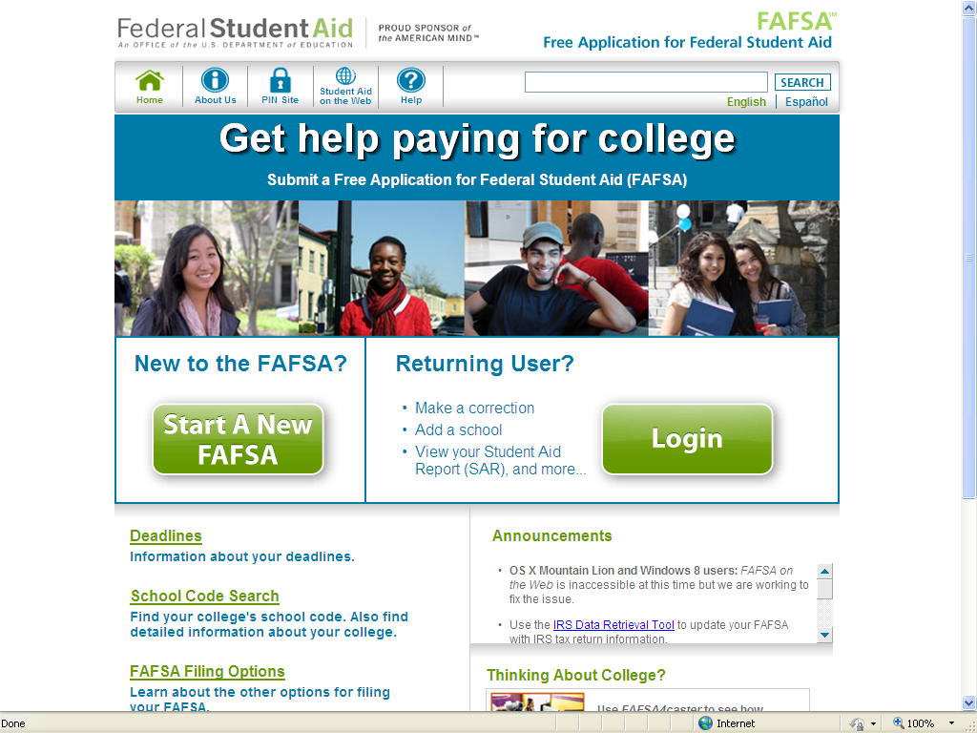
FAFSA.gov
Notes:
Here is a screen shot of the FAFSA website so you know where to go.
We recommend that ALL students should complete the FAFSA. Again, FAFSA stands for the FREE Application for Federal Student Aid.

Slide 12
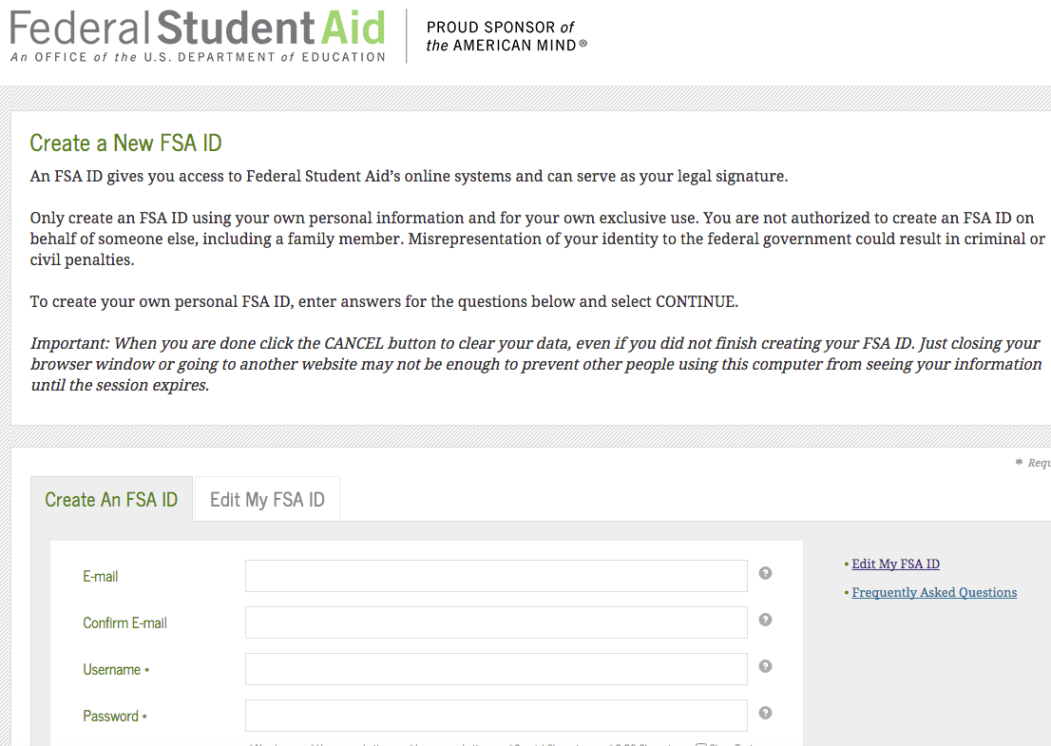
FAFSA: Federal Student Aid ID (FSA ID)
Students, and at least one parent, should apply for the FSA ID
Apply online while filing the FAFSA or ahead of time by going directly to FSAID.ed.gov
Notes:
Prior to filing the FAFSA, we recommend that the student and one of their parents apply for the Federal Student Aid ID (FSA ID) online at FSAID.ed.gov.
As part of the FSA ID application, the student and parent will each create a username and password to replace the use of personal information and to electronically sign the student’s FAFSA. If either the student or parent have filed a FAFSA before and have a PIN number, this new process will require them to establish an FSA ID to replace their PIN.
If a parent does not have a valid social security number, they will not be able to apply for the FSA ID. Instead, the parent will need to print a signature page at the end of the student’s FAFSA application to sign and mail to Federal Student Aid processing. The mailing address is listed on the FAFSA signature page.
Here are some quick tips to help make the FSA ID application process easier:
Parents and students should each create their own FSA IDs.
Students and parents cannot share the same email address to create their FSA IDs.
Students and parents should have access to their email accounts when creating the FSA ID.
Read the FAQ portion of the FSA ID website if you get stuck or confused by any part of the process.
Click on the symbols to the right of the challenge questions to carefully review the required parameters.
Use cheat sheets, such as those provide by HESC, to record all important information including: FSA IDs, FAFSA Key, and the student’s HESC TAP Username and PIN number.

Slide 13
FAFSA: Student Section
Student Information & Eligibility
Basic info: address, email, name of high school, citizenship, Selective Service Registration, and other eligibility status questions
College Information
Up to 10 colleges; can be updated or corrected
Dependency Determination
Questions to determine student’s dependency status
Notes:
In preparation for filing the FAFSA, students and parents should try to assemble all of the information needed to complete the application successfully.
The first few sections of the online FAFSA is completed by the student and contains the following:
The Student Information and Eligibility Section is where students provide demographic information and answer basic eligibility questions. This includes questions about their address, email, name of high school, citizenship, Selective Service Registration, and other eligibility status questions.
The College Information Section is where students can enter up to 10 colleges on the FAFSA. Each college listed will receive the results of the FAFSA but they will not be able to see the list of other colleges that the student has applied to. Keep in mind this college list can be updated after the FAFSA is processed through the online FAFSA. Make sure each of the student’s prospective colleges have received at least one submission of the FAFSA.
The Dependency Determination section is where the student answers a series of questions to determine if they are a dependent or independent student for federal student aid purposes. If the student is determined to be dependent, then parental information must be supplied to complete the application.

Slide 14
FAFSA Question: Student Eligibility
What are some of the most important eligibility qualifications for FAFSA?
Students must be U.S. citizens or eligible non-citizens
Students must have valid Social Security Numbers
Male students must register or be registered with the US Selective Service System
Notes:
Now let’s discuss the eligibility to receive federal aid.
In order to receive federal aid, a student must be a U.S. citizen or eligible non-citizen.
They must also have a valid social security number, and, male students between the ages of 18 and 26 must register with selective service.

Slide 15
FAFSA Question: Student Dependence
Can a student apply for the FAFSA without reporting their parent’s information?
In most cases, students under 24 years of age are required to report parent information
Students with special circumstances should consult with the financial aid office
Notes:
Do students need to provide their parents’ information?
Yes. Students are required to provide their parent or parents’ information if they do not meet the FAFSA criteria for independence.
FAFSA asks a series of questions about the student to determine if they can qualify to apply as an independent student. Based on the answers to these questions, the application will either ask for parent information or guide you through the application as an independent student.
If you have a special circumstance that is not reflected on the FAFSA form you should reach out to the college financial aid office for assistance.

Slide 16
FAFSA: Parent, Income, & Signature Sections
Parent Information & Income Sections
Marital status, name, date of birth, SSN, state of residence
Household size, Number in college
Income reported on 2015 federal income tax return
Untaxed income, asset information
Student Income Section
Did the student work in 2015?
Signature Section
Notes:
The remaining FAFSA sections are the Parent Information, Parent Income, Student Income and Signature section.
The Parent Information Section requests information about the student’s parents, such as their marital status, name, date of birth, Social Security Number. Parents who do not have a valid Social Security Number can enter all zeros for the question. Answers in this section about the parent’s household size and number of dependents in college play a critical role in determining the student’s Expected Family Contribution (EFC).
The Parent Income Section asks for information about parent income and assets. The FAFSA requires parents to report both taxed and untaxed income from two years prior to start of the student’s first year in college, also referred to as prior-prior year income. If parents file income taxes, the FAFSA will request prior-prior year federal tax return information. For the graduating senior class of 2017, this means using the parent’s 2015 income and federal tax information. Asset values are reported as of the day the FAFSA form is being submitted. Be sure to follow the FAFSA instructions carefully about which asset information needs to be reported.
In the Student Income Section, students also must provide similar income information as the parent, if they have any taxed or untaxed income to report from the prior prior year.
Lastly, in the Signature Section both the student and parent can electronically sign the application using their Federal Student Aid ID. If a parent was unable to apply for a FSA ID, they can sign using the FAFSA signature page process described earlier.

Slide 17
FAFSA Question: Parent Marital Status
FAFSA requires parents to report their marital status as of the day the application is being filed
If a parent is divorced or separated, and not remarried, then the custodial parent only needs to report their info
Custodial parent is the parent the student resided with the most over past 12 months
If both parents live together then both must report info, even if unmarried and not filing taxes together
If a parent is currently remarried then a stepparent must report their info and income
Notes:
FAFSA requires parents to report their marital status as of the day the application is being filed
If a parent is divorced or separated, and not remarried, then the custodial parent only needs to report their info. The custodial parent is the parent the student resides with the most over the past 12 months.
If both parents live together then both must report info, even if unmarried and not filing taxes together
If a parent is currently remarried then a stepparent must report their info and income

Slide 18
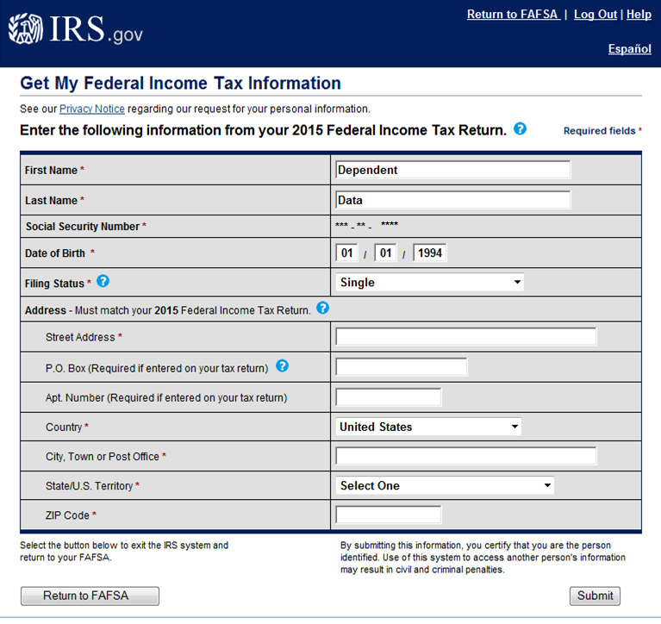
Reporting Tax Info: IRS Data Retrieval Tool
Transfers required federal income tax data to the FAFSA
Helps avoid having to submit copies of IRS tax transcript to colleges
Notes:
It is highly recommended that FAFSA applicants use the IRS Data Retrieval Tool (DRT) for the Parent and Student Income Information Sections. The DRT allows parent and/or student tax-filers to retrieve any required federal income tax information from the IRS website to automatically answer the income tax questions on the FAFSA.
However, for a variety of reasons, not everyone may be able to use it.
You cannot use the IRS Data Retrieval Tool if you:
filed an amended federal return (1040X)
filed as Married Filing Separately
filed a foreign tax return
File taxes using an Individual Taxpayer Identification Number (ITIN) instead of a Social Security Number
You will be brought to this page to complete the information necessary to initiate the data transfer.
You must be careful to enter the home address exactly as it appears on your tax return, including all abbreviations and punctuation. An exact match is needed to complete any tax information transfer.
Successfully using the retrieval tool will eliminate requests from colleges for copies of the IRS Tax Transcript to verify tax information.

Slide 19
FAFSA Question: Reporting Assets
Do you report the value of your home or retirement accounts on the FAFSA?
The value of your primary residence and any tax deferred retirement accounts are excluded
Any real estate investment property must be reported as an asset
What about businesses and the value of business assets?
Only reported if the business has more than 100 employees
Notes:
Here are some common asset questions.
Do you report home values or retirement accounts on the FAFSA as an asset?
The value of your primary residence and tax deferred retirement accounts can be excluded. However, the value of any real estate investment property must be reported as an asset.
What about businesses and the value of business assets?
You would only need to report these values if the business has more than 100 employees.

Slide 20
FAFSA Question: Reporting Assets
Are UGMA/UTMA accounts, trust funds, savings bonds, or any other asset belonging to the student reported on FAFSA?
Current market value of these student-owned assets must be reported in the student income/asset section
How are 529 college savings plans treated?
The value of 529 Plans, for all children, must be reported in the parent income/asset section
Notes:
Are UGMA/UTMA accounts, trust funds, savings bonds, or any other asset belonging to the student reported on FAFSA?
The current market value of these student-owned assets must be reported in the student income/asset section.
How are 529 college savings plans treated?
The current market value of 529 Plans, for all children, must be reported in the parent income/asset section.

Slide 21
FAFSA: Federal Student Aid Programs
Pell Grant
Supplemental Educational Opportunity Grant (FSEOG)
Work-Study
Perkins Loan
Direct Stafford Loan
Direct PLUS Loan
Notes:
Here is a list of federal programs that are administered through the US Department of Education’s Office of Federal Student Aid.
To qualify for any of these programs the student must submit a FAFSA application.
The Pell Grant is the grant most commonly awarded by the federal government. For the 2016-2017 school year, Pell Grants may be awarded up to $5,815 per year. However, qualifying for the program and the exact amount awarded will depend on the student’s Expected Family Contribution.
The Supplemental Educational Opportunity Grant (or SEOG), Work-study, and the Perkins Loan program are all awarded based on available funding at colleges. College financial aid offices determine eligibility and will consider students for these programs during the application review process.
Direct Stafford loans are federal loans in which the student is the borrower and will be responsible for repayment. A Direct PLUS loan is a loan where the parent is the borrower and they are responsible for repayment.
**Please refer to the “How To Pay for College” Booklet to learn more about the federal student loan programs. There we discuss more details about each of the federal student loan options including eligibility and interest rates.**

Slide 22
Federal Pell Grant
Need-based grant
Award amount based on COA, EFC and enrollment status
Must maintain good academic standing
Currently, up to $5,815
Notes:
The Pell Grant is an entitlement program- which means if you are eligible, you will receive the grant. It is usually awarded to students with a higher financial need.
The grant is determined based on your COA, EFC, and your enrollment status. You must be in a matriculated program and taking at least three credits to be eligible. You also need to be in good academic standing while you are enrolled in college.
Currently, you can receive up to $5,815 per year. Your college will determine your exact Pell grant award and notify you in their financial aid award letter.

Slide 23
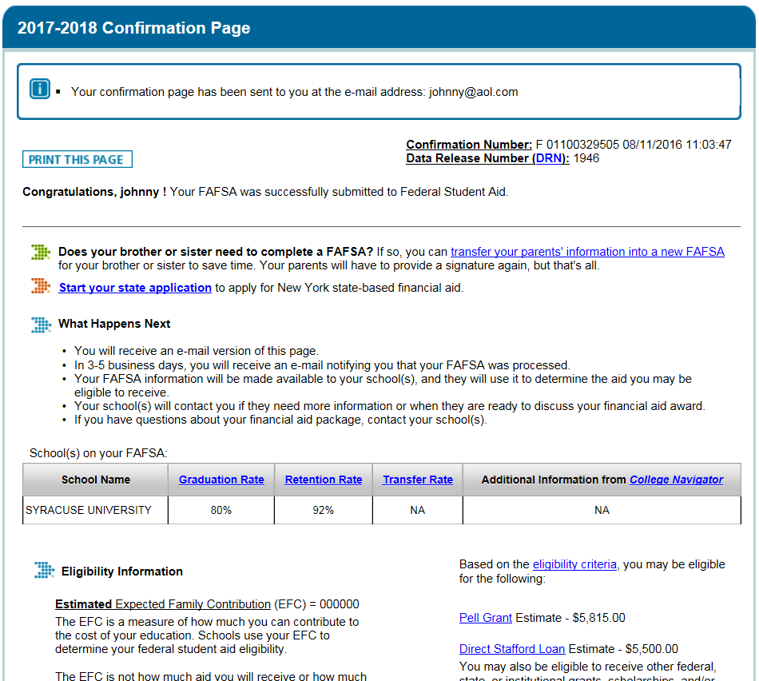
Applying for New York State Aid
Notes:
Once you successfully complete the FAFSA, you will see the confirmation page.
If you indicated you are a resident of New York State and listed at least one college located in New York State on the FAFSA application, the link highlighted in this screen shot will be present on the confirmation page. Using the link will bring you to the HESC TAP application web portal. Make sure pop-up blockers are set to allow pop-ups on the FAFSA website!
First time TAP applicants will need to establish a HESC User ID and PIN number as part of the application process.

Slide 24
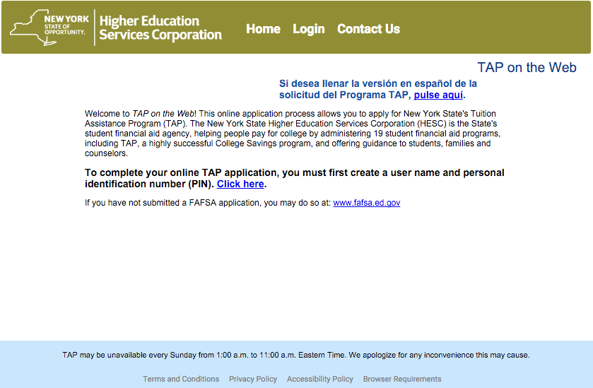
Anytime TAP-on-the-Web Application
Notes:
Using the link will bring you to the HESC TAP application web portal. Make sure pop-up blockers are set to allow pop-ups on the FAFSA website!
First time TAP applicants will need to establish a HESC User ID and PIN number as part of the application process.

Slide 25
NYS Student Aid Programs: TAP
Tuition Assistance Program (TAP)
Undergraduates
Need-based, up to $5,165/year
Full-time and part-time study in NYS
Based on NYS Income Tax information
Notes:
The Tuition Assistance Program (TAP) is New York State’s need-based grant program. TAP is awarded to help cover tuition costs only and may be available for either full or part-time students attending a college in New York State.
Currently, the maximum TAP award is up to $5,165 per year. Qualifying for TAP and the exact amount awarded will depend on student and parent New York State taxable income.

Slide 26
Other NYS Student Aid Programs
New York Achievement & Investment in Merit Scholarship (NY-AIMS)
STEM Incentive Program
Math & Science Teaching Incentive Program
More info at hesc.ny.gov
Notes:
New York State administers a number of grant, scholarship and award programs. A few of these programs are listed here and the complete list can be found on the hesc.ny.gov website.
Some programs, like the NYS Math and Science Teaching Incentive Program, have a service component which students would be required to complete after completing college.

Slide 27
NYS Achievement & Investment in Merit Scholarship (NY-AIMS)
$500 annual award for study in NYS
Students must achieve two of the following criteria
graduate with a GPA of 3.3 or above
graduate “with honors” on a NYS Regents diploma
score 3 or higher on two or more AP exams
graduate in top 15% of high school class
Apply at hesc.ny.gov in May senior year
Notes:
New York State also offers merit-based aid options, such as the NYS Achievement & Investment in Merit Scholarship, or NY-AIMS.
The NY-AIMS scholarship provides a $500 renewable award for study in New York State. Students can apply for this program if they meet two of the following criteria:
-graduated from high school with a GPA of 3.3 or above
-received a “with honors” designation on their NYS Regents diploma
-received a score of 3 or higher on two or more Advanced Placement (AP) examinations
-graduated within the top 15% of their high school class
Students can apply online for this program on hesc.ny.gov starting in May of their senior year.

Slide 28
NYS STEM Incentive Program
Provides full tuition scholarship for students attending SUNY or CUNY colleges
For undergrad programs leading to degree in Science, Technology, Engineering or Mathematics
Student must be ranked in top 10% of high school senior class to qualify
Must execute a service agreement with NYS
Apply at hesc.ny.gov in January of senior year
Notes:
In addition to NY-AIMS, New York State offers the NYS STEM Incentive Program that awards full in-state tuition scholarships to attend SUNY or CUNY colleges or universities.
To qualify, applicants must be:
graduating seniors that are ranked in top 10% of their high school class
studying at a SUNY or CUNY college or university in an undergraduate program leading to a degree in Science, Technology, Engineering or Mathematics
There is a service commitment in which a student must agree to work and reside in New York State for five years after completing their education and must work in an approved STEM field. Anyone who is interested in this program may apply online at hesc.ny.gov beginning in January of their senior year of high school.

Slide 29
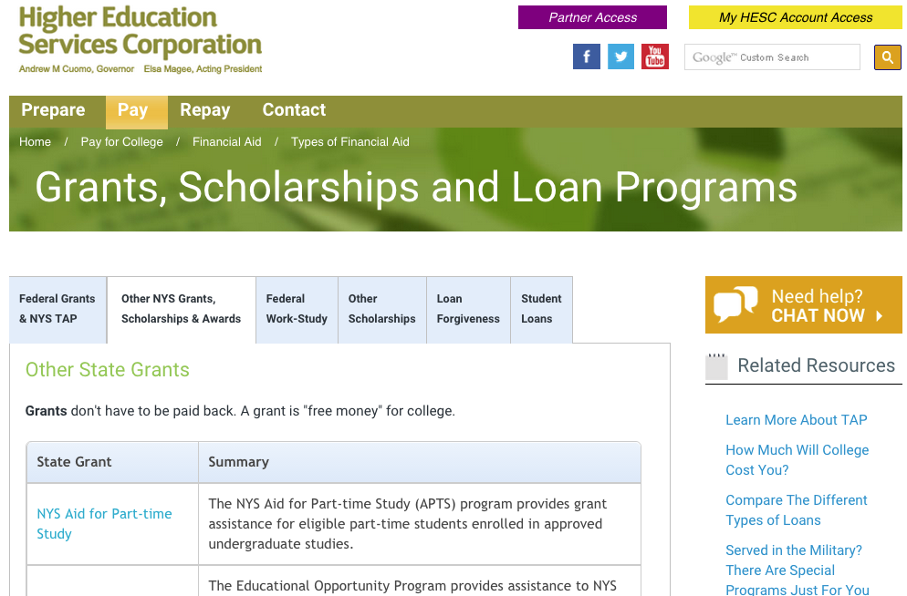
Apply for New York State Scholarships, Other Programs: HESC.ny.gov
Notes:
If you are interested in applying to other New York State student financial aid programs, such as our state scholarship programs, then you can go to the HESC website at HESC.ny.gov. Under the “Pay” tab you will see a link to Other NYS Grants, Scholarships & Awards.

Slide 30
Institutional Aid
Depends on funding at each college
College determines eligibility criteria for need-based and non-need-based programs
Academic, athletic, and other talent-based scholarships and grants
May require an additional application
Notes:
Colleges also provide their own financial aid programs, known as institutional aid. Each college sets their own eligibility criteria for both need-based and non-need based financial aid programs.
Many colleges use the FAFSA application to determine eligibility for need-based institutional aid programs. Some colleges require another financial aid application, such as The College Board’s CSS Profile, to be considered for need-based institutional aid. We will discuss the CSS Profile application a bit later.
Merit-based institutional grants and scholarships may be based on academic, athletic, and other talents. Make sure the college is aware of any special skill or talent you have so you are considered for any of these special awards.
Be sure to keep track of all the different deadlines and applications required at the schools to which you are applying. Funds may be limited, so be sure to complete required applications as early as possible.
A college’s financial aid website can provide you with information on the availability of institutional aid programs, required applications, and deadlines.

Slide 31
Applying for Institutional Aid
Depends on the college’s requirements
Admissions application for merit-based awards
FAFSA for need-based institutional aid
Does the college require the CSS Profile?
More detailed financial aid application available at The College Board
Available starting October 1st
Requires a fee but fee waivers may be available
Notes:
When researching your colleges you want to make sure you fully understand how their institutional aid works. Offering institutional aid is completely at the discretion of the college and the amount of funding they provide and eligibility criteria will vary.
Here are some important questions you should be asking your college:
What is the criteria for receiving institutional aid?
If you are a student who will have a lot of need, will the college meet that full need with institutional aid?
Is institutional aid at the college awarded based on need-based criteria, merit, or both?
For many colleges, the FAFSA will provide a basis for need based institutional aid. Colleges have a limited amount of institutional grant and scholarship money, so be sure to complete the FAFSA early.
However, some colleges require an additional financial aid application to be considered for this type of aid. The CSS Profile application is one the most common institutional aid applications. You will want to keep track of all the different deadlines and applications required at the schools to which you are applying. You do not want to miss any opportunity to receive FREE institutional money.

Slide 32
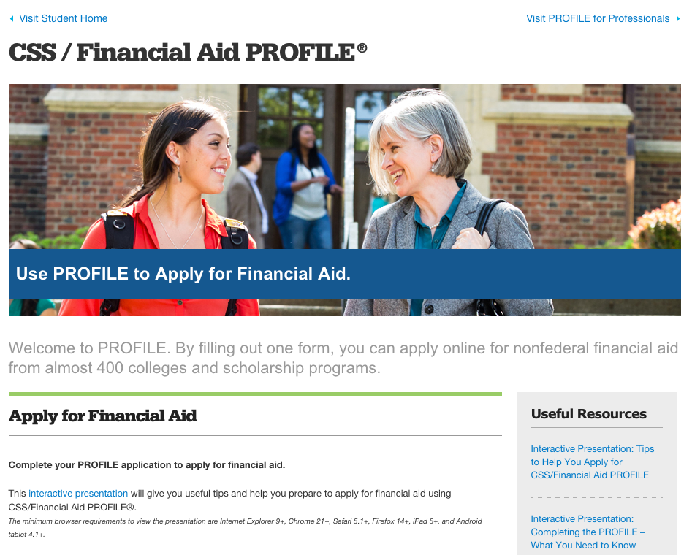
Apply for CSS Profile: Collegeboard.org

Slide 33
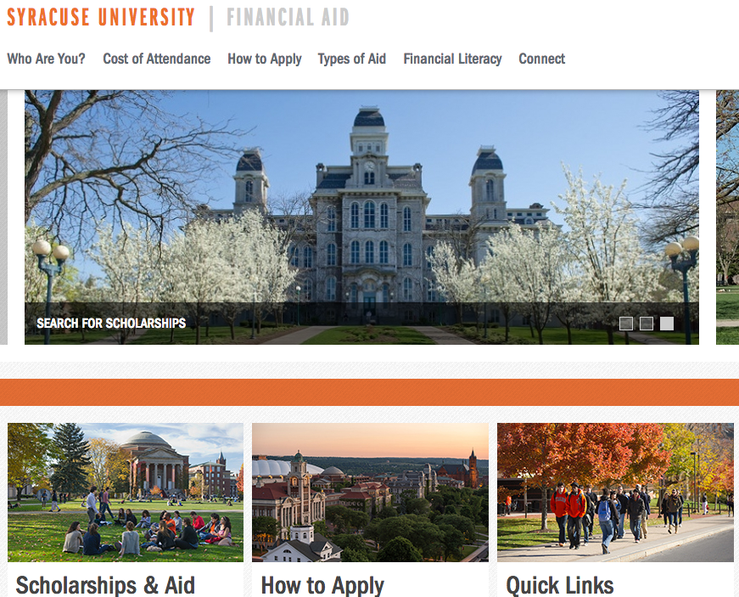
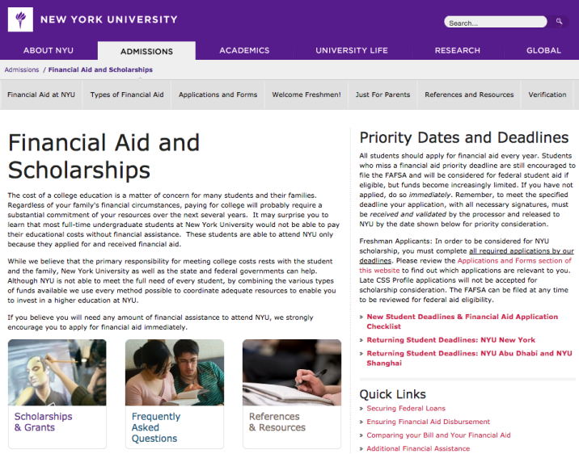
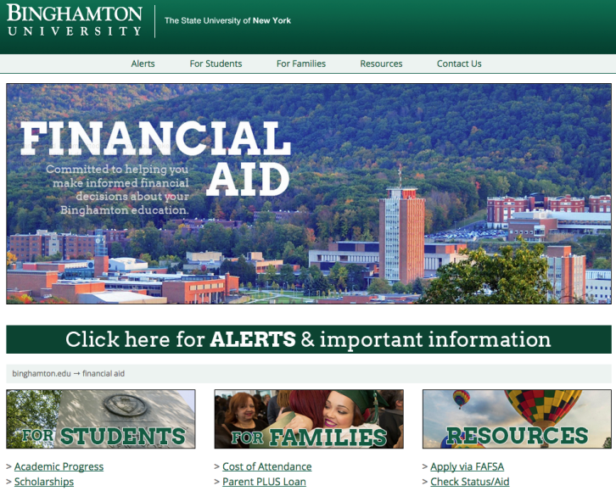
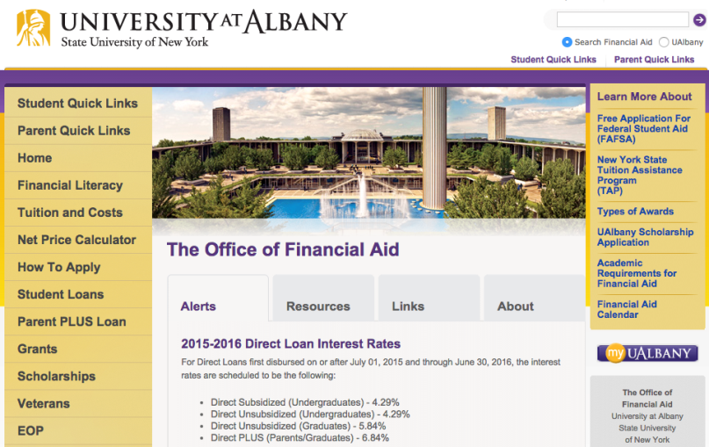
Research College Financial Aid Websites
Notes:
A great way to find out more details about a particular college’s institutional aid programs, application requirements, and deadlines, is to carefully research financial aid on their website.
Here are some examples of financial aid web pages that show important information including application requirements and deadlines along with links to find out more about their cost of attendance and institutional aid programs.
You want to make sure you read any information they provide carefully, so you do not miss out on any aid opportunities!

Slide 34
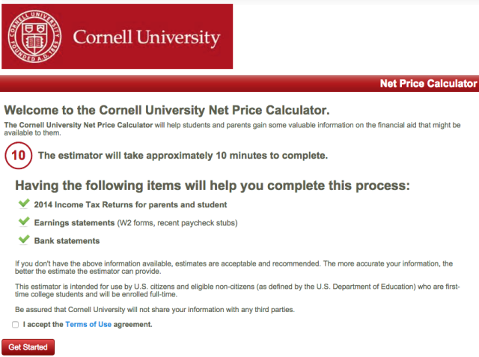
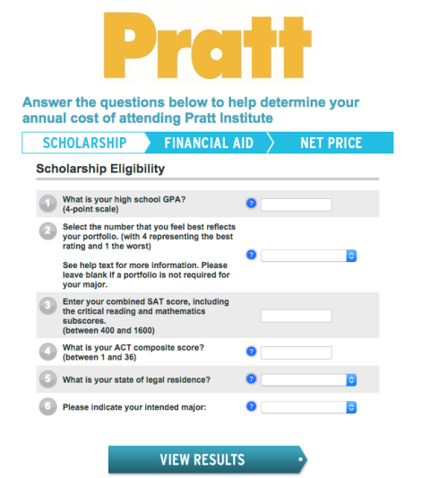
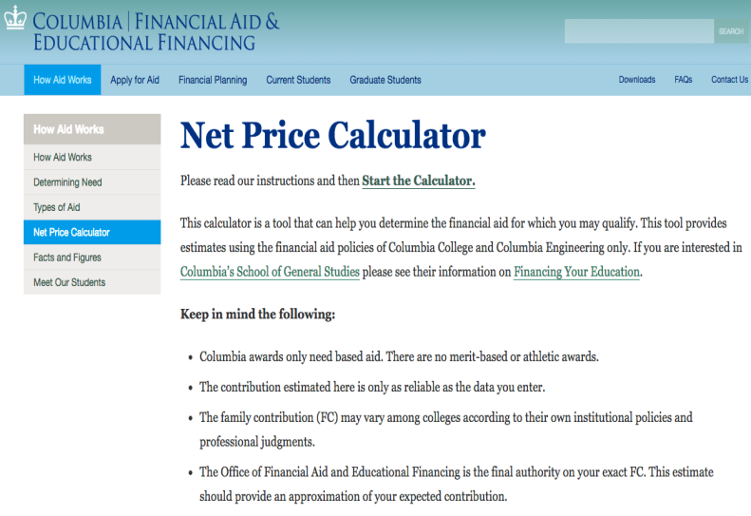
Use Net Price Calculators
Notes:
When researching a college’s financial aid website, it may be helpful to utilize their Net Price Calculator.
Net price calculators allow you to enter your information, such as your household size and income, to generate an estimate of a specific college’s cost of attendance, average aid package (based on what families with similar demographics have received), out-of-pocket costs, average indebtedness, and average net price – which is the result of subtracting cost of attendance from grant aid.
Net price calculators vary in format from school to school. The results are estimates and averages to be used as a planning tool only, as schools cannot be held liable to meet the figures presented within the calculation.
Be sure to check out the websites of all the colleges you are considering for more information!

Slide 35
Other Financial Aid Opportunities: Private Scholarships
Online scholarship search websites
Fastweb.com
Collegeboard.org
Scholarships.com
Check local library, employer or union
Avoid scholarship scams
Unnecessary fees, ID theft
www.studentaid.ed.gov/types/scams
Notes:
Now let’s talk about scholarship searches.
While you are gathering information about your colleges and applying for federal, state, and institutional aid, you want to be sure to spend some time researching scholarship opportunities available from private sources or “outside aid.”
There are thousands of private-sponsored programs and millions of dollars available each year that come from a variety of sources, such as businesses, religious institutions, employers, unions, and civic organizations.
Some students and parents prefer to use the internet as a way of searching for these programs. Here are a few popular scholarship search websites where you can begin your private scholarship search.
In addition, your high school counselor or college advisor may have some scholarship opportunities they can recommend.
You should begin your scholarship search now. Each of these programs have their own application process, deadlines, and requirements. So, the earlier you start the easier it will be to apply for as many different opportunities as possible.
When searching for private scholarships be careful of scams in which companies issue fraudulent guarantees that they can get scholarships on behalf of students or fake scholarship awards or lists in exchange for fees. Make sure that any organization, program or website you are using to search and apply for scholarships is legitimate before providing personal information.

Slide 36
Financial Aid Tips
Apply early!
Update the FAFSA school list to make sure all of your colleges are listed
Respond quickly to all verification, document requests
Financial aid offices are the best places to get questions answered
May 1st is national college decision day
Notes:
Here are some quick tips to keep in mind to ensure your financial aid process goes smoothly.
Remember, the FAFSA, TAP and CSS Profile applications are all available on October 1st. Filing early will help ensure you meet all of your college’s filing deadlines and provide you with your financial aid eligibility information in advance of making decisions about which colleges to apply to.
Be sure to update your school list on your FAFSA application to ensure that all of your prospective colleges are listed in at least one submission. Remember, you can add or delete colleges using the online FAFSA correction process as you are submitting college admissions applications throughout the Fall.
Also, make sure that you respond quickly to any requests from colleges that seeking additional financial information or documents as part of the financial aid verification process. Delaying your response to these requests can lengthen the amount of time it takes for colleges to get back to you with a financial aid offer.
Keep in mind that the financial aid offices are the best resources for any questions you may have about the financial aid process.
Lastly, May 1st is national college decision day. You want to make sure everything is finalized with your prospective colleges regarding the financial aid process well in advance of that day. Having a finalized financial aid offer in advance of May 1st will help you make an informed decision about your college choice.

Slide 37
Questions?
NYS Higher Education Services Corporation
99 Washington Avenue
Albany, NY 12255
www.hesc.ny.gov
1-888-NYSHESC (1-888-697-4372)
Notes:
Thank you for attending HESC’s presentation “Student Financial Aid: What Every High School Students and Parents Should Know.” We hope you found the information useful in your quest to learn more about student financial aid opportunities and the application process.
Our agency website and customer call center number is listed here for future reference. Please feel free to reach out to us should you have any questions about New York State student financial aid programs.
Does anyone have any questions?

