Slide 1
WELCOME Class Of 2017
Administration
Susan Elliott, Principal
Sharon Applebaum, Assistant Principal
John J. Duggan, Assistant Principal
Peter Gottfried, Dean
Sally Passarella, Dean

Slide 2
The College Application Process
September 2016
Notes:
Welcome to College Night!
You are here because you have questions about getting into college, and you may want to know what you have to do in high school to prepare. You may wonder about standardized tests. You probably have questions about the applications process. Finally, you probably want information about financial aid. You probably feel overwhelmed by all this, but let’s take things one step at a time.

Slide 3
Diploma Name Verification Survey
Please complete the survey located on Infinite Campus in your Inbox as soon as possible
Your name will appear on your high school diploma as shown on Infinite Campus unless you indicate a change in this survey.
You will also be asked about ordering caps and gowns and if your parent(s) work in the district.

Slide 4
Counselor Contact Information Phone: 516-441-4820
Carly Bank
Jo-AnnEyre Cruz (Department Chair)
Chris Erickson
Allison Gottfried
Gillian O’Connell
Stacey Rapp
Joe Stopanio

Slide 5
Narrowing Down Your List
“Reach” schools
“Target” schools
“Safer” schools
GOAL:
Find your perfect match:
Academically
Socially
Financially
Notes:
Your Guidance Counselor will be meeting with you individually to go over what would be your target schools, but from year to year the applicant pool can change therefore there is no guarantee on this process. Your counselor will help you choose schools that will be a good match.
Discuss Finding a good match.
While considering where to apply, narrow your choices down to about six schools. You want to give yourself a range of choices, so don’t put all your eggs in one basket.
Apply to two “safe” schools: Currently enrolled students at these colleges should have lower average GPA and standardized test scores than you do. You should feel that you have a 75–90 percent chance of getting in.
Apply to two “reach” schools: These schools should be difficult for you to get into. Students enrolled should generally have higher GPAs and standardized test scores than you do. Often, these are extraordinarily difficult schools for anyone to get into.
Apply to two “good fit” schools: Students should have GPAs and test scores similar to yours. These should be schools that you would be happy to go to and where you have a good chance of getting in.

Slide 6
College Visits On Campus
*Register for Information Session and Tour with Admissions Office
What to do on your visit:
Meet with representatives (Send Thank You)
Take a campus tour
Sit in on a Class
Speak with the students on campus
Eat in the dining hall – taste the food!
Check-out the surrounding community
Pick up the school newspaper
Plan for an overnight visit
Notes:
Deciding on a college can be tough; however, it can also be a lot of fun. Consider what each college has to offer. You might want to look at aspects such as:
Size: Do you want a larger university with a large, diverse population and mostly lecture-style classes? Or do you want a smaller school with more contact with professors?
Public or private: Private colleges and universities are generally more expensive than public schools and usually have a smaller student population as well.
Location: Is the school close to home? Is it in a large city or a small town?
Cost: How much is tuition? What about housing?
Majors: Do they have a program in your line of study?
Student Life: What’s the atmosphere like on campus? Is it a student-friendly and fun environment? What do students have to say about their school?

Slide 7
College Representative Visits at South High School
Key connections can be made during these visits
Schedule updated daily through Naviance
Register for visit through your Naviance account
Communicate with teacher of class you may need to miss
Be prepared with specific questions
Send a Thank You note/email
https://connection.naviance.com/family-connection/auth/login/?hsid=gnshs

Slide 8
Application Deadlines
Early Decision/Early Decision 2
Early Action-Single Choice or Restricted
Regular Admission
Rolling Admission
Priority Deadlines (For admissions and scholarships)
*Be aware of deadlines set by colleges and the guidance office
Notes:
Look for application deadlines and apply early. Colleges usually begin accepting applications after the first quarter of your senior year. Check with individual colleges.
If you definitely know where you would like to go to college, you may apply using early decision or early action. Both of these options involve applying early in your senior year. You will receive notification from the college in December, January, or February. Do keep in mind, however, that early decision is binding. In other words, if the college accepts you and offers you an adequate financial aid package, you must go there.
Early action is not binding. You may still apply to other colleges as part of regular admissions; however, many schools won’t allow you to apply to other schools as part of early action.

Slide 9
Transcript
GPA is calculated through junior year
Senior year grades count - Do your best
Great Neck South does not Rank
Great Neck South does not Weight
Transcripts must be verified by September 16th.
Notes:
Generally speaking, two of the most important considerations for college admissions and academic scholarships are grade point averages and ACT/SAT scores.
If you already have a high GPA, congratulations! You’ve made things a lot easier for yourself.
If you take AP or honors courses, many colleges will weight them—thus, getting a B+ in a difficult course will count for more than getting an A- in an easier course.
If you didn’t do as well in your freshman and sophomore years as you believe you could have, turning your GPA around in your junior and senior years will have an impact on your admission. Also, if you have a learning disability or something else in your life that has hurt your academics, you should mention it in your personal essay or have a counselor or other adult describe it in your letters of recommendation. Admissions officers don’t just look for someone who has a perfect GPA and perfect test scores. They want well-rounded individuals or people who have overcome some difficulties.
After you’ve won acceptance to a college, don’t slack off for the rest of your senior year! Many college acceptance letters are contingent on you maintaining your current GPA.

Slide 10
SAT/ACT SCORES
www.act.org
www.collegeboard.com
www.fairtest.org
*Students must send ACT/SAT scores through ACT and/or College Board if required.
*Please allow 3-4 weeks for scores to be received by colleges.

Slide 11
ACT Test Dates http://www.actstudent.org
TEST DATE | REGISTRATION DEADLINE
Saturday Sept. 10, 2016 | August 5, 2016
Saturday Oct 22, 2016 | September 16, 2016
Saturday Dec 10, 2016 | November 4, 2016
Acceptable Photo ID is mandatory!
Scores via web are available 2-3 weeks after test date
Click the ACT link below for standby registration requirements
http://www.actstudent.org/regist/standbytest.html

Slide 12
SAT Test Dates https://sat.collegeboard.org/home
No Admission Ticket…No Test…No Exceptions!
Walk-In/Wait-list must register online:
Can only be done after registration deadline closes - MUST be 5 days prior to the test date.
*This does not guarantee a seat – see below for more information
http://sat.collegeboard.org/register/waitlist-status
No changes in test date, type or location are permitted unless indicated on admission ticket!
TEST DATE | REGISTRATION DEADLINE
Saturday Oct 1, 2016 | September 3, 2016
Saturday November 5, 2016 | October 7, 2016

Slide 13
College Application Essay Tips
Who are you, how have you grown, what sets you apart from others in the applicant pool?
Maximum is 650 words and minimum is 250. Even one character above or below these parameters will hinder your ability to submit your applications.
Supplemental Essays

Slide 14
The Process
Student Questionnaire must be given to DIRECTLY to your guidance counselor
Speak with teachers about letters of recommendation and provide them with your Teacher Recommendation Request forms (PEACH)-Optional
Meet with Counselor often through each step of the process
Match your Naviance Account with Common App (Must use your school email address) Refer to https://vimeo.com/102639828 for instructions
Complete FERPA through Common App
Submit SAT/ACT scores directly to Colleges
Submit College Application/Transcript Release/FERPA form DIRECTLY to guidance counselor (GREEN FORM)
If applying to a CUNY School use the CUNY Application/Transcript Release/FERPA (Yellow Form)
Review College Application Checklist

Slide 15
FORMS
Senior Checklist
Guidance Questionnaire
FERPA Release (on-line)
College Application/Transcript Release Form (Green)
CUNY College Application/Transcript Release Form (Yellow)
Teacher College Recommendation Request Form (Peach)
Common Application Hints
College Representative Visits to GNSHS

Slide 16
Requesting Letters of Recommendation
Initial requests should be made in person and Thank You notes are always appreciated when handing your peach request form in.
Official request – invite teacher through Naviance
Click on “Colleges”
Click on “Colleges I am Applying to”
Assign recommenders at the bottom of the page and an email request will be sent to the recommenders
Teacher Recommendation Release Forms (Peach)
Optional
Notes:
Make sure that you can count on a positive letter of recommendation. If you aren’t sure, ask!
Give the person writing the letter at least two weeks notice before the mail date. Not only is it rude to ask for a letter of recommendation at the last minute, but most people will write a better letter if you give them more time.
Furnish the person writing the letter with a list of accomplishments, or provide them with a resume. [Note to presenter: a form for this purpose is provided.]
Send them a thank you note.
Save a copy of these recommendations for future use.

Slide 17
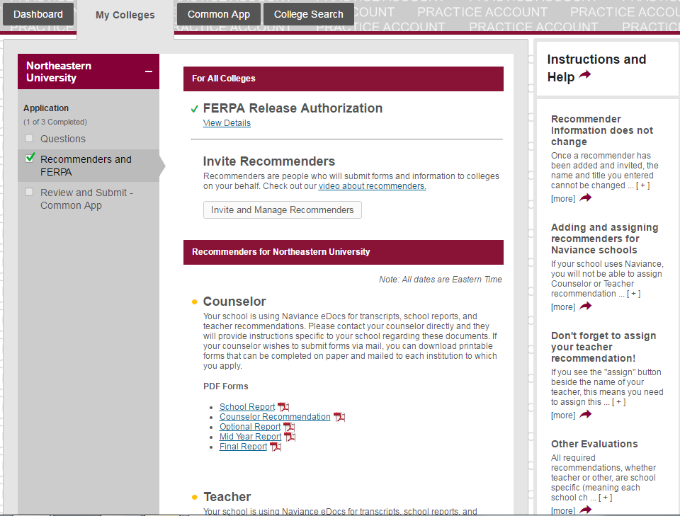
Students Do Not have to invite teachers or counselors through Common App. Counselor and Teacher materials are sent through Naviance.

Slide 18
Guidance Office will send…
Official transcripts
Secondary school report
Counselor recommendation
School profile
Mid-Year Report Card
Final Transcript

Slide 19
National Collegiate Athletic Association (NCAA)
Division I & II college-bound athletes MUST register with NCAA (www.eligibilitycenter.org)
Inform your counselor once you have completed registration
Complete Athletic Interest Forms at colleges you are interested in
Communicate with HS and college coaches
Speak with your counselor now!

Slide 20
Financial Aid Workshop
Wednesday, September 15, 2016
7:30pm Big Changes to FAFSA FAFSA: File after October 1st of Senior year at www.fafsa.ed.gov CSS Profile: This form applies to some colleges; please check with colleges for details and deadline; available on www.collegeboard.com - New York State Higher Education Services Corporation www.HESC.com
Financial Aid (Net Price) Calculator
Notes:
FAFSA stands for “Free Application for Federal Student Aid.”

Slide 21
Package will be comprised of:
Need Based Awards
Merit Based Awards
Athletic Awards
Financing your Education
Notes:
Make time to apply for scholarships. Keep your eyes open for scholarship opportunities for which you might be a good candidate. There are three types of scholarships: Academic, Departmental, and Private.
Colleges commonly award money to students based on grades and test scores. Schools also frequently consider community service and extracurricular involvement. They like to see that you have the potential to contribute both academically and socially. Look for ways to get involved in school and in your community that will show colleges you are a well-rounded individual.
If you have a particular talent or know exactly what you want to study in college, contact people in those departments in the schools which you apply. Once again, don’t be afraid to pick up the phone. Let them know who you are and how you can contribute to their department.
If you have a particular talent or know exactly what you want to study in college, contact people in those departments in the schools which you apply. Once again, don’t be afraid to pick up the phone. Let them know who you are and how you can contribute to their department.
Many large companies offer help to children of their employees. Ask your parents to find out if their employers have any programs for which you may be eligible. These programs are usually not need-based or merit-based.
Local businesses may offer scholarships to high school students in the area. If a company has supported the school through ads in the student newspaper or yearbook, they may have scholarships available.
Philanthropists, charitable organizations, religious groups, and other groups also offer scholarships. Look into local opportunities, and if you’re not sure if a particular organization offers a scholarship, don’t be afraid to ask.

Slide 22
SCHOLARSHIPS
www.fastweb.com
meritaid.com
www.collegeboard.com
www.scholarships.com
*Great Neck Student Aid Fund

Slide 23
You Submitted…. Now What???
Check your student email frequently for information from colleges and your guidance counselor
Check the status of your applications at each specific school. Be mindful of the time it takes for colleges to process applications
Continue attending college visits at South High
Keep working hard in all classes
Keep your Guidance Counselor informed of your progress

Slide 24
WE ARE HERE TO HELP IN EVERY WAY!
THANK YOU FOR ATTENDING!

